Slide 1
Dielectric Heating
(Industrial Electronics)
Engr. M. Laiq Ur Rahman

Slide 2
Dielectric Heating
When an insulating material is subjected to an alternating electric field, the atoms get stressed and because of the inter-atomic friction, heat is produced.
This heating process is known as dielectric heating.
This inter-atomic friction caused by repeated deformation and rotation of the atomic structure (polarization).

Slide 3
Electronic Theory of Dielectric Heating
When an atom is not under any electric field, the centers of the positive and negative charges coincide as shown in following figure, and atom acts as a neutral particle.
When the atom is subjected to an electric field, the charge distribution is disturbed.
The atom in this state is said to be polarized.
As the electric field is increased, the degree of polarization keeps increasing.

Slide 4
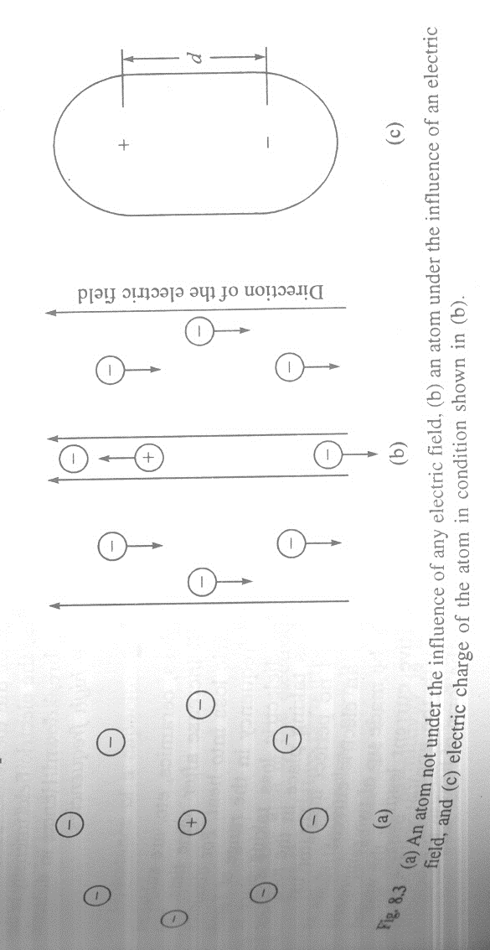
Electronic Theory of Dielectric Heating

Slide 5
Electronic Theory of Dielectric Heating
It is seen that the loss increases with the increase in frequency and strength of the electric field.
If the electric field is very strong, it may result in a rupture of the dielectric medium.
Hence in dielectric heating, it is desirable not to apply high voltages but to use high frequencies.

Slide 6
Principle of Operation of Dielectric Heating
In this process, the job (material to be heated) is placed in between two electrodes and the electrodes are fed with a high frequency supply.
The arrangement is shown in following figure.
The two electrodes act as the two plates of the capacitor and the job acts as the dielectric material between two electrodes.

Slide 7
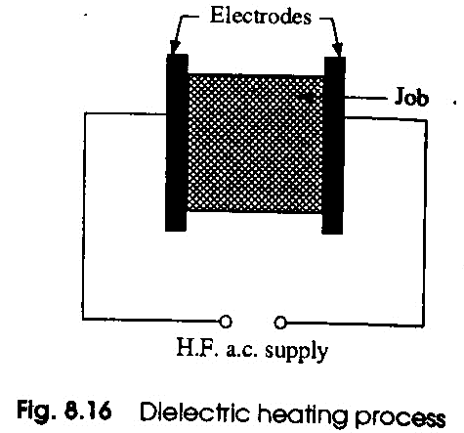
Principle of Operation of Dielectric Heating

Slide 8
The current flowing in the circuit is given by:
I_{c} = E/X_{c}
Where
I_{c} is current flowing through capacitor
E is high-frequency supply voltage
X_{c} is capacitive reactance.
The phenomenon of dielectric loss (heating) taking place in insulating materials is just analogous to the hysteresis loss in magnetic materials.

Slide 9
Sources of High Frequency Supply for Dielectric Heating
Dielectric heating operates on the principle of converting high frequency electric energy into heat energy.
The basic arrangement of dielectric heater is shown in following figure.
The ac supply voltage is stepped up by means of a step-up transformer and further rectified by a bridge rectifier.

Slide 10
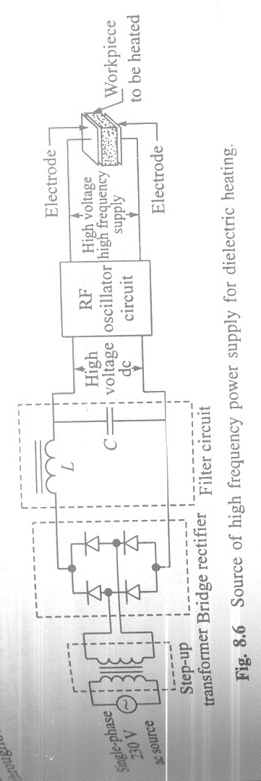
Sources of High Frequency Supply for Dielectric Heating

Slide 11
Sources of High Frequency Supply for Dielectric Heating
The ripple components are minimized by the use of an LC filter.
This ripple free high voltage dc is fed to an RF oscillator.
This RF oscillator produces high frequency, i.e., about 1MHz or above.
Since the energy conversion takes place throughout the work piece, the heating effect is uniform.

Slide 12
Dielectric Heating Equation
The dielectric loss is given by
P = E²*2*π*f*A*K₀*K_{r}*δ / d
Where
A is area of electrode
K₀ is absolute permittivity
K_{r} is relative permittivity
δ is phase angle (complement of power factor angle
d is distance between electrodes.

Slide 13
Factors affecting Dielectric Heating
The amount of heat generated is directly proportional to
Square of the Supply Voltage
Frequency
Area of the electrode plates
Relative permittivity of dielectric
Power factor
And inversely proportional to
Distance between two electrodes.

Slide 14
Salient Features of Dielectric Heating
As far as possible, a uniform electric field should be employed. For this, the two essential conditions are
The electrodes should be larger than the size of job
The length of electrodes should be more than the distance between them.
There is a limit up to which the supply voltage should be limited to avoid corona and arcing effect.

Slide 15
Salient Features of Dielectric Heating
The charge must touch each plate. There should be no air gap between the electrodes which will otherwise introduce series capacitance and cause loss of efficiency.
In case of heating non conducting material, dielectric heating is the most efficient method for uniform heating.

Slide 16
Applications
This method is extensively used in plastic and wood industries.
It is specially of immense utility where multiply woods are to be heated and glued.
This method is also employed in the textile, rubber, chemical and food industries.
Sterilization of food and medical supplies.
Plastic sheets are joined together by the technique involving a combination of heat and pressure.

Slide 17
Applications
This technique is very useful for manufacturing plastic products such as raincoats and waterproof products etc.
This method is also used for manufacturing polyvinyl material products.
Dielectric heating using RF circuits is a quicker method of heating as compared to others.

Slide 18
Issues or Problems
When a job is being heated the air dielectric is replaced by the job which causes variation in resonant frequency of tuning circuit.
The electrode structure is to be designed properly.
For efficient heating proper field is to be established within the job being heated.
Voltage gradient is another problem. Because of non uniform voltage gradient non uniform heating takes place.

Slide 19
Issues or Problems
Some air gaps will exist between electrodes and job for a number of reasons such as
Irregular shape of the job.
Keeping provision for movement of job between electrodes.
Non uniform heating required for different parts of the job, etc.

Slide 20
Difference between Induction Heating and Dielectric Heating
Induction heating is caused by eddy currents in imperfect dielectrics.
Dielectric heating depends on the electrostatic effect.
The operating frequencies are of the order of 200 to 500 kHz in induction heating.
The operating frequencies range from 1 to 50 MHz in dielectric heating.

Slide 21
Difference between Induction Heating and Dielectric Heating
Induction heating is termed surface heating.
Dielectric heating is termed volume heating.
The cost of equipment required in induction heating is low.
The cost of equipment required in dielectric heating is comparatively high.

